Slide 1
EECS 498 System Design of a Search Engine
Winter 2026
Lecture 22: Organizational behavior, authority, and the legal environment
Nicole Hamilton
https://web.eecs.umich.edu/~nham/
nham@umich.edu

Slide 2
agenda
details
organizational behavior
legitimacy of authority
getting people to do stuff
leadership styles
the legal environment
Vamika’s quandary

Slide 3
agenda
details
organizational behavior
legitimacy of authority
getting people to do stuff
leadership styles
the legal environment
Vamika’s quandary

Slide 4
details
Nothing new.

Slide 5
agenda
details
organizational behavior
legitimacy of authority
getting people to do stuff
leadership styles
the legal environment
Vamika’s quandary

Slide 6
OB
Organizational behavior (OB) deals with how people behave in organizations, how they organize into hierarchical and other structures, how they establish authority and motivate members to set and achieve their goals.

Slide 7
groups vs organizations
Lots of groups are ad hoc, just whoever shows up.
May or may not have leaders.
May or may not have any organization.
But business organizations choose their members, they have leaders, and they organize into reporting structures.

Slide 8
business organizations
The usual purpose of any business organization is to:
Establish who is responsible for what and to whom
Define roles and responsibilities
Establish control mechanisms and policies

Slide 9
simplest organization
Consider a small business with a few employees.
The reporting relationships are shown on an org chart.
Business owner
Employee A
Employee B
Employee C

Slide 10
simplest organization
Even the simplest organizations typically involve breaking up the work between people with different jobs.
Consider a restaurant.
Manager
Bookkeeper
Cook A
Wait staff A
Wait staff B
Cook B
Wait staff C

Slide 11
span of control
The number of direct reports to a manager is limited by the possible span of control.
If the activities are diverse and complex, that limits the span of control.
If the activities are standardized or the manager and workers are highly skilled, a wider span of control is possible.
Ultimately, the limit is typically between 5 and 12 direct reports.
Manager
Employee 1
Employee 3
…
Employee 2
Employee n

Slide 12
functional organization
To grow beyond the limit of one manager’s possible span of control, business organizations introduce hierarchy.
For example, a typical high-tech startup might have a simple functional organization. Each of the vice presidents might have their own organizations.
President
VP Engineering
VP Marketing
& Sales
VP Finance
VP Manufacturing

Slide 13
hierarchy
For example, here might be a typical engineering organization.
VP Engineering
Hardware Development
Test
Program Management
Software Development

Slide 14
staff vs. line
Line organizations carry out the principal business of the organization and have decision-making authority.
Staff organizations provide shared or advisory services.
President
Human Resources
VP Engineering
VP Marketing
& Sales
VP Finance
VP Manufacturing
Legal

Slide 15
staff vs. line
The distinction is also made between managers who have “people responsibility” and staff who do not.
Many companies have a “dual ladder”.
Section
Manager
Senior
Engineer
Junior
Engineer
Junior
Engineer
Associate
Engineer

Slide 16
divisions
To grow still larger, businesses create divisions along product lines.
Often, divisions are goaled and measured as a profit centers, allowing them operate as largely independent businesses.
President
Spy Satellites
Small
Arms
Breakfast
Cereals
Chemical
Weapons

Slide 17
divisions
Regional divisions are another option at any scale, e.g., dividing up sales by region, engineering projects between labs, manufacturing between plants.
Manager
US
Asia &
Australia
Middle East
Europe

Slide 18
committees
Organizations will often create and assign work to committees.
They may be either standing committees or created as a task force to tackle a particular problem.
Committees typically have a chairman but the members are drawn from around the organization and don’t usually report to the chairman.

Slide 19
agenda
details
organizational behavior
legitimacy of authority
getting people to do stuff
leadership styles
the legal environment
Vamika’s quandary

Slide 20
organizing people
Ultimately, the objective of a business organization is to get people to work together, respecting the lines of authority.
This brings up questions of legitimacy of authority and how to motivate people.

Slide 21
legitimacy of authority
Legitimacy of authority refers to the perceived right of an authority figure to have power and control over others.
This can be based on various factors, such as expertise, position, and tradition.

Slide 22
legitimacy of authority
Your boss has legitimate authority because they can fire you.
Police have legitimate authority because they can arrest you.
Teachers have legitimate authority because they’re presumed to know what they’re talking about and they can grade their students’ work.

Slide 23
illegitimate authority
Not all authority is legitimate.
Some random person offering their opinion on Facebook probably isn’t a legitimate authority unless they have special expertise.
A home invader with a gun can force you to do things but they are not a legitimate authority because they’re breaking the law.
A manager who starts every meeting with sexist or racist jokes or who treats employees unfairly might be obeyed, but their authority won’t be seen as legitimate.

Slide 24
agenda
details
organizational behavior
legitimacy of authority
getting people to do stuff
leadership styles
the legal environment
Vamika’s quandary

Slide 25
getting people to do stuff
There are various theories and evidence about what motivates people and how to do stuff.
Scientific management
The Hawthorne effect
Human Relations Movement
Maslov’s hierarchy
Theory X
Theory Y
Theory Z

Slide 26
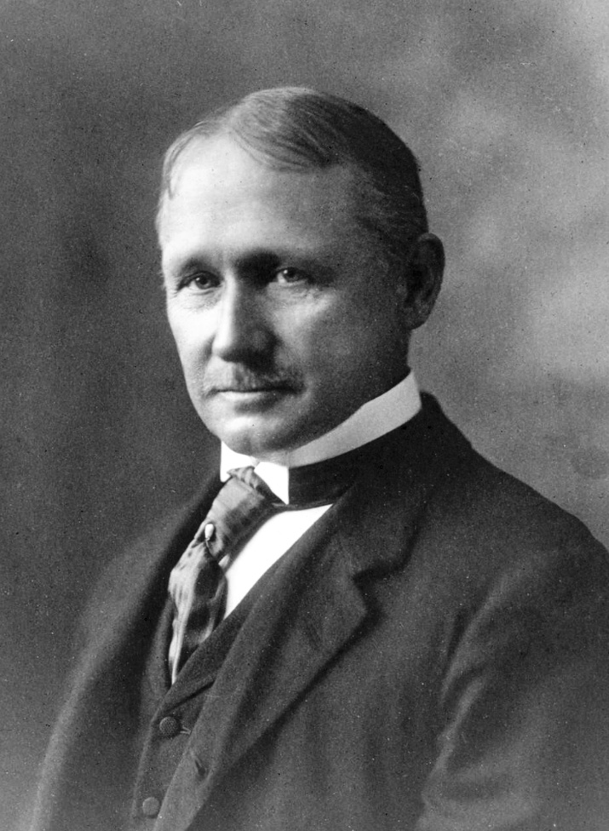
scientific management
In the late 1800s/early 1900s, Frederick Taylor, an American mechanical engineer, used time and motion studies to show that by breaking down a complex task into smaller tasks, each task could be studied to find the most efficient way of doing it.

Slide 27
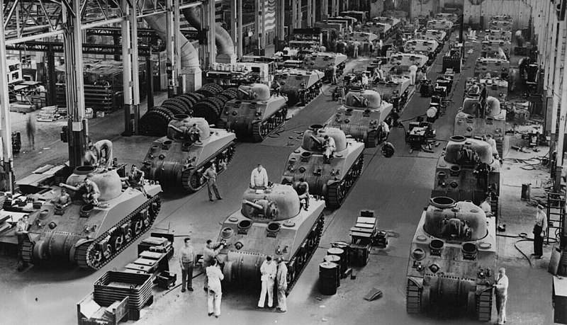
scientific management
Took off during World War II, when production bottlenecks forced the government to turn to scientists and engineers to help increase production.
They began to create mathematical models to apply to production problems, a branch of OB called operations research.

Slide 28
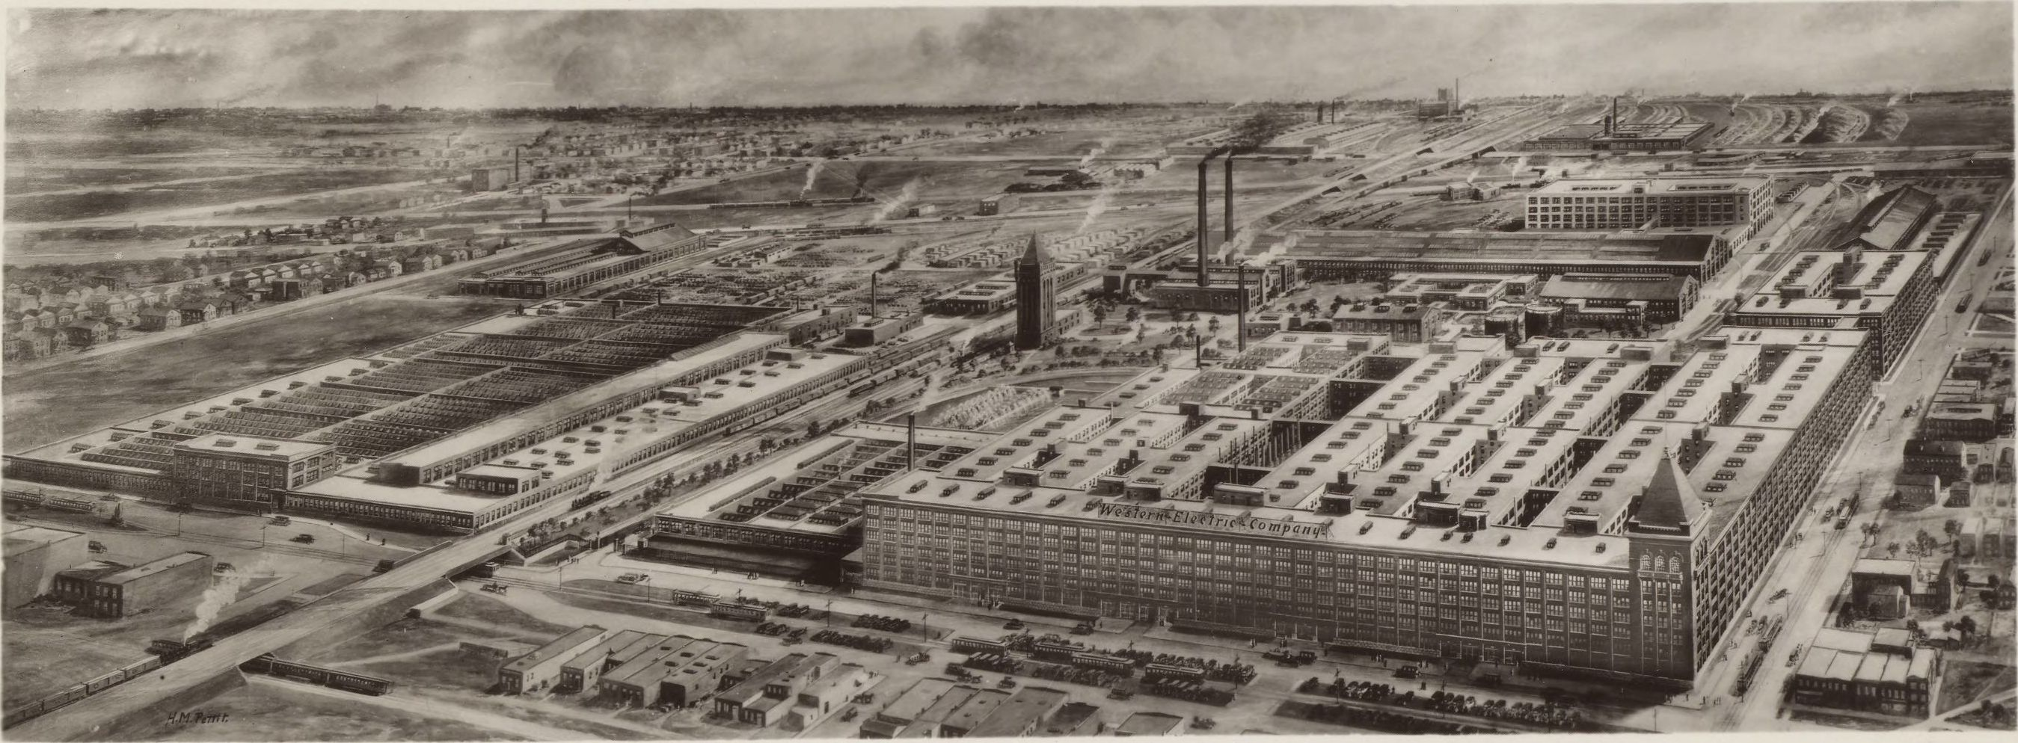
Hawthorne studies
Between 1924 and 1932, Harvard psychologist Elton Mayo conducted a (later criticized) series of studies at Western Electric’s Hawthorne Works near Chicago to determine if they could optimize productivity by adjusting the light level up and down until they found the perfect level.

Slide 29
Hawthorne studies
Every time they changed the light, it didn’t matter whether it was up or down, productivity improved until they ended the study, at which point, productivity slumped.

Slide 30
Hawthorne effect
Coined in 1958 by Henry Landsberger to describe the way people modify their behavior when they’re aware they’re being observed.

Slide 31
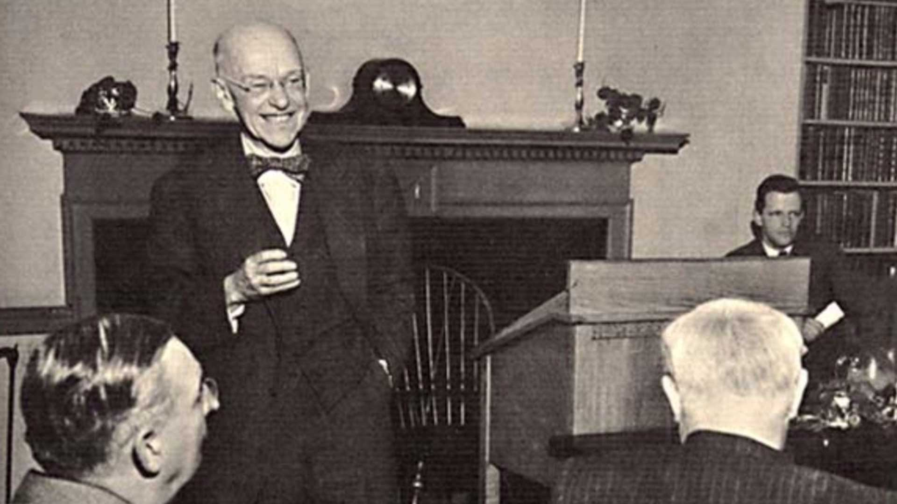
Human Relations Movement
Based on these studies, Mayo argued that workers are "social beings" who perform better when they feel valued, heard, and part of a team.

Slide 32
Human Relations Movement
The Human Relations Movement he founded emphasized that employee motivation and productivity are driven more by social factors, recognition, and group dynamics than by monetary incentives or physical work conditions.

Slide 33
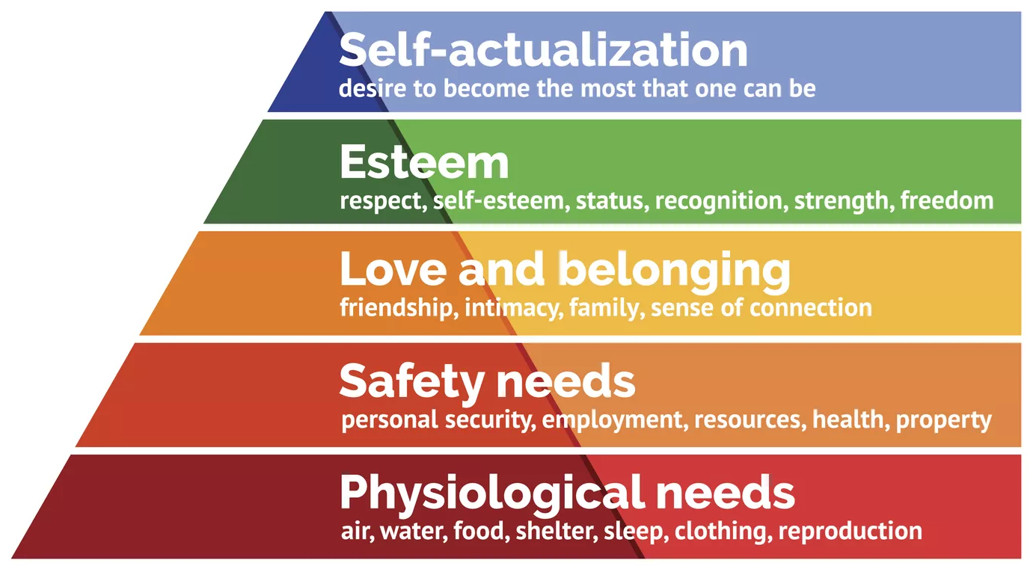
Maslov’s hierarchy of needs
In 1943, American psychologist Abraham Maslov proposed that certain basic needs must be met before individuals can progress up the hierarchy to more complex needs.
Image source: https://www.thoughtco.com/maslows-hierarchy-of-needs-4582571

Slide 34
theory x
In 1960, Douglas McGregor at MIT renamed Taylor’s scientific approach to management Theory X.
Under Theory X, people are inherently lazy and need to be motivated to work with a combination of rewards and punishments. They lack creativity and ambition and they’re there simply to work.

Slide 35
theory y
He also renamed Mayo’s behavioral approach Theory Y.
Under Theory Y, people are self-motivated if they have a supportive environment. They’re inventive and should be given responsibility and consulted for their ideas.

Slide 36
theory z
In the 1980s, William Ouchi called the version of theory X used in Japan theory Z.
Under theory Z, managers and workers work together in cohesive work groups using consensus for decisions. To improve quality, they use quality circles.
Every employee is involved in kaizen – the continuous struggle to improve.

Slide 37
agenda
details
organizational behavior
legitimacy of authority
getting people to do stuff
leadership styles
the legal environment
Vamika’s quandary

Slide 38
agenda
details
organizational behavior
legitimacy of authority
hierarchy of needs
leadership styles
the legal environment
Vamika’s quandary

Slide 39
agenda
details
organizational behavior
legitimacy of authority
getting people to do stuff
leadership styles
the legal environment
Vamika’s quandary

Slide 40
culture
Organizations develop a culture around the way they treat people.
Consider:
IBM’s “open-door” and “respect for the individual” policies in the 1970s.
Microsoft’s “stack ranking” (finally ended in 2013).
Amazon’s “two pizza” rule.

Slide 41
policy
Organizations will also use policies and practices to enforce their culture and avoid problems.
Examples:
Rules regarding liquor at a company event.
Prohibitions on engaging in a relationship with a subordinate.
Defined working hours.
Job titles and descriptions.
Periodic performance reviews.
Complaint procedures.
Award programs.
Periodic training on issues like discrimination and bias.

Slide 42
common leadership styles
Authoritarian
Participative
Delegative
Transactional
Transformational

Slide 43
common leadership styles
Authoritarian
Participative
Delegative
Transactional
Transformational
An autocratic style where the boss makes all the decisions with little input from others.

Slide 44
common leadership styles
Authoritarian
Participative
Delegative
Transactional
Transformational
A democratic style where decisions are commonly up for debate by the entire team.
Downside is that it can be indecisive.

Slide 45
common leadership styles
Authoritarian
Participative
Delegative
Transactional
Transformational
A laissez-faire style where employees are given a lot of freedom and autonomy. They set their own schedules and priorities.
Requires employees who don’t require much direction, e.g., research faculty.

Slide 46
common leadership styles
Authoritarian
Participative
Delegative
Transactional
Transformational
A managerial style that focuses on performance targets and rewards and penalties for meeting or not meeting the targets.
Often seen in sales organizations.

Slide 47
common leadership styles
Authoritarian
Participative
Delegative
Transactional
Transformational
Transformational leaders energize their teams with a vision.
Steve Jobs and Jeff Bezos are examples.

Slide 48
agenda
details
organizational behavior
legitimacy of authority
getting people to do stuff
leadership styles
the legal environment
Vamika’s quandary

Slide 49
the legal environment
Some people have multi-year contracts or tenure appointments that make it hard to fire them.
But most employees in the US at “at will”, meaning they can be terminated at any time for any reason as long as it’s not a prohibited reason like disability, gender, age, race, religion, national origin, and so on.
The reason doesn’t have to be true. You can be fired because they don’t like your red tie even if you don’t own and have never worn a red tie.

Slide 50
Title VII of the Civil Rights Act of 1964
Title VII makes it illegal to discriminate against someone on the basis of race, color, religion, national origin, or sex.
The law also makes it illegal to retaliate against a person because the person complained about discrimination, filed a charge of discrimination, or participated in an employment discrimination investigation or lawsuit.
The law also requires that employers reasonably accommodate applicants' and employees' sincerely held religious practices.

Slide 51
Pregnancy Discrimination Act
Amended Title VII to make it illegal to discriminate against a woman because of pregnancy, childbirth, or a medical condition related to pregnancy or childbirth or retaliate because they complained.

Slide 52
The Equal Pay Act of 1963 (EPA)
This law makes it illegal to pay different wages to men and women if they perform equal work in the same workplace or retaliate because someone complained.

Slide 53
The Age Discrimination in Employment Act of 1967 (ADEA)
This law protects people who are 40 or older from discrimination because of age.

Slide 54
Title I of the Americans with Disabilities Act of 1990 (ADA)
This law makes it illegal to discriminate against a qualified person with a disability in the private sector and in state and local governments or retaliate because they complained.

Slide 55
The Genetic Information Nondiscrimination Act of 2008 (GINA)
This law makes it illegal to discriminate against employees or applicants because of genetic information or retaliate because they complained.
Genetic information includes information about an individual's genetic tests and the genetic tests of an individual's family members, as well as information about any disease, disorder or condition of an individual's family members (i.e. an individual's family medical history).

Slide 56
adverse employment action
An adverse employment action is anything that affects the terms or conditions of your job that negatively affects you.
It can be anything from extra hours, a less-desirable assignment, a demotion, termination, or anything that decreases your chances of promotion.
They can usually do this.
They just can’t do it for an illegal discriminatory reason or in retaliation for a complaint about discrimination.

Slide 57
as a practical matter
It is very difficult to prove discrimination.
There’s often lots of plausible deniability in why they treated you badly, especially if it’s the result of a committee decision.
This is why most attorneys will not be willing to accept a discrimination case on contingency unless it’s a class action case where they demonstrate consistent discrimination against large numbers of members of the protected class.

Slide 58
as a practical matter
If you believe you have been the victim of illegal discrimination or retaliation, you are allowed to complain to your employer and/or to the EEOC, which will investigate your complaint.
EEOC investigations average 10 months.
If they find your complaint was justified, they may try to negotiate a resolution. If they don’t find sufficient evidence, they will issue a “right-to-sue” letter, meaning you can sue on your own.

Slide 59
as a practical matter
If you do decide to pursue an individual case of discrimination, you have to pay for it up-front. Expect it to cost anywhere from $30K to $500K and take up to 5 years.
If you win, you will be entitled to lost wages, which you will be expected to have attempted to mitigate by finding another job.
You may be entitled to punitive damages but only if the employer’s conduct was egregious, which has a different meaning in the law. If they didn’t actually rape you, it probably doesn’t qualify.

Slide 60
as a practical matter
Employers are not allowed to retaliate because you complained, regardless of how often you’ve complained or whether your complaint has any merit.
Because it can be easier to relate an adverse action to a complaint, and the complaint doesn’t have to be proved valid, it can be easier to prove retaliation than discrimination.

Slide 61
as a practical matter
If you’re being mistreated by your employer, you may not have many choices.
It’s not illegal for them to make you miserable as long as it’s not for a protected reason.

Slide 62
as a practical matter
Most cases eventually settle before going to court.

Slide 63
as a practical matter
HR is not your friend.
Their job is to make sure the company never gets sued. Or if they ever do get sued, they never lose.

Slide 64
as a practical matter
It often comes down to deciding whether to stay or go.
It matters who you have in your life. They can help you or not.
Every day you waste with the wrong person is a day you might have spent with the right person.

Slide 65
agenda
details
organizational behavior
legitimacy of authority
getting people to do stuff
leadership styles
the legal environment
Vamika’s quandary

Slide 66
agenda
details
organizational behavior
legitimacy of authority
hierarchy of needs
leadership styles
the legal environment
Vamika’s quandary

Slide 67
Vamika’s quandary
Based on an actual case, “Vamika’s Quandary: Navigating Through Workplace Mistreatment”, Copyright 2023, Ivey Business School Foundation.

Slide 68
facts of the case
Vamika Arora graduated from law school during the pandemic and had great difficulty finding a job.
She finally found work in August 2020 as a paralegal at Darby & Fox LLP, an employment law firm in London, as a paralegal in Aug 2020 on a one-year contract.
As a newly-hired contract worker, she was required, unlike anyone else, to work at the empty office.
She endured overwork, disrespect, after-hours assignments, phone calls with shouting, job threats, and conflicting assignments.

Slide 69
the hierarchy
Athena Ainsworth, Equity Partner
Jeff Heaney, Sr Partner and VP HR
Julian Allos, Associate Partner
Rafi Al Jamil, Associate Partner
Vamika Arora, contract paralegal

Slide 70
the hierarchy
Athena Ainsworth, Equity Partner
Jeff Heaney, Sr Partner and VP HR
Julian Allos, Associate Partner
Rafi Al Jamil, Associate Partner
Vamika Arora, contract paralegal
Two weeks after she starts, she’s assigned to work for Rafi Al Jamil.

Slide 71
the hierarchy
Athena Ainsworth, Equity Partner
Jeff Heaney, Sr Partner and VP HR
Julian Allos, Associate Partner
Rafi Al Jamil, Associate Partner
Vamika Arora, contract paralegal
But before she gets her assignment, she gets an email from Allos, demanding that he come to his office.
It starts badly with Allos when he has her standing outside his door for 15 minutes for their first meeting.

Slide 72
the hierarchy
Athena Ainsworth, Equity Partner
Jeff Heaney, Sr Partner and VP HR
Julian Allos, Associate Partner
Rafi Al Jamil, Associate Partner
Vamika Arora, contract paralegal
She finds she has two bosses and their demands are sometimes conflicting.

Slide 73
the hierarchy
Athena Ainsworth, Equity Partner
Jeff Heaney, Sr Partner and VP HR
Julian Allos, Associate Partner
Rafi Al Jamil, Associate Partner
Vamika Arora, contract paralegal
A lot of Allos’s tasks are more complex than would be assigned to a paralegal.
Assignments and feedback are vague, e.g., demanding corrections without specifying they just wanted an extra comma.

Slide 74
the hierarchy
Athena Ainsworth, Equity Partner
Jeff Heaney, Sr Partner and VP HR
Julian Allos, Associate Partner
Rafi Al Jamil, Associate Partner
Vamika Arora, contract paralegal
Emails were always respectful, but Allos often called in the evenings and was often rude and shouting at her on the phone.

Slide 75
the hierarchy
Athena Ainsworth, Equity Partner
Jeff Heaney, Sr Partner and VP HR
Julian Allos, Associate Partner
Rafi Al Jamil, Associate Partner
Vamika Arora, contract paralegal
It reaches a head when Allos sends an email asking Arora to pick up a book at the library.
She doesn’t see the email until that night and replies that’s she’s gone home.

Slide 76
the hierarchy
Athena Ainsworth, Equity Partner
Jeff Heaney, Sr Partner and VP HR
Julian Allos, Associate Partner
Rafi Al Jamil, Associate Partner
Vamika Arora, contract paralegal
Allos is furious and warns, “You might lose your job soon.”
He copies Heaney on an email criticizing Arora’s work.

Slide 77
the hierarchy
Athena Ainsworth, Equity Partner
Jeff Heaney, Sr Partner and VP HR
Julian Allos, Associate Partner
Rafi Al Jamil, Associate Partner
Vamika Arora, contract paralegal
Arora asks Jamil for advice.
He tells her not to respond, that he would speak to Allos.

Slide 78
the hierarchy
Athena Ainsworth, Equity Partner
Jeff Heaney, Sr Partner and VP HR
Julian Allos, Associate Partner
Rafi Al Jamil, Associate Partner
Vamika Arora, contract paralegal
Jamil raises the issue at the next partner’s meeting but in a heated argument is accused of influencing Arora’s insubordination.

Slide 79
the hierarchy
Athena Ainsworth, Equity Partner
Jeff Heaney, Sr Partner and VP HR
Julian Allos, Associate Partner
Rafi Al Jamil, Associate Partner
Vamika Arora, contract paralegal
After the meeting, Allos and Ainsworth approach Heaney to complain about Jamil.

Slide 80
the hierarchy
Athena Ainsworth, Equity Partner
Jeff Heaney, Sr Partner and VP HR
Julian Allos, Associate Partner
Rafi Al Jamil, Associate Partner
Vamika Arora, contract paralegal
Arora learns that Allos and Jamil are rivals.

Slide 81
the hierarchy
Athena Ainsworth, Equity Partner
Jeff Heaney, Sr Partner and VP HR
Julian Allos, Associate Partner
Rafi Al Jamil, Associate Partner
Vamika Arora, contract paralegal
Ainsworth and Allos are married and have a reputation for shrewdness and spiteful behavior.

Slide 82
the hierarchy
Athena Ainsworth, Equity Partner
Jeff Heaney, Sr Partner and VP HR
Julian Allos, Associate Partner
Rafi Al Jamil, Associate Partner
Vamika Arora, contract paralegal
Heaney calls Arora to his office where he tells her it was a misunderstanding and some bruised egos and that the matter is closed.

Slide 83
the hierarchy
Athena Ainsworth, Equity Partner
Jeff Heaney, Sr Partner and VP HR
Julian Allos, Associate Partner
Rafi Al Jamil, Associate Partner
Vamika Arora, contract paralegal
Heaney quits and Ainsworth becomes senior partner.

Slide 84
the hierarchy
Athena Ainsworth, Equity Partner
Jeff Heaney, Sr Partner and VP HR
Julian Allos, Associate Partner
Rafi Al Jamil, Associate Partner
Vamika Arora, contract paralegal
Ainsworth asks Arora to obtain two extra signatures for time off. No other paralegal is asked to do this.

Slide 85
the hierarchy
Athena Ainsworth, Equity Partner
Jeff Heaney, Sr Partner and VP HR
Julian Allos, Associate Partner
Rafi Al Jamil, Associate Partner
Vamika Arora, contract paralegal
It’s March 2021 and Arora is 8 months into her 12-month contract.
She’s miserable. She’s overworked and mistreated.
What should she do?

Slide 86
questions
1. What made Vamika an easy target for her mistreatment?
2. If it had happened in the US, would they have broken the law?
3. Assuming most good managers aren't sociopaths intent on mistreating employees, even if when it is perfectly legal, what went wrong at this firm to have allowed this to happen?
4. How did the organization and reporting structure contribute? Would that be allowed at most companies?
6. If you were Vamika and it was happening to you here in the US, describe your options. What would you do and why?

Slide 87
what made Vamika an easy target
She was a recent graduate from law school.
She needed a job and it was hard to find one during Covid.
She was new and temporary at Darby & Fox, a “rented mule”.
She’s young and female.

Slide 88
would they have broken the law in the US?
Probably not. No clear evidence that the mistreatment was the result of discrimination based on protected status retaliation for a protected complaint.
Additionally, Darby & Fox is an employment law firm. They probably know how to stay precisely inside the line.

Slide 89
Assuming managers aren't sociopaths, how did this happen?
Maybe they are sociopaths.
We could be dealing with a husband-and-wife pair of two sociopaths, Athena Ainsworth and Julian Allos.
Studies suggest that perhaps 5% of the population has antisocial personality disorder but most are completely functional.
Being a sociopath or a psychopath can apparently even be an advantage in some professions.

Slide 90
characteristics of psychopathy
Shallow emotions and reduced fear), stress tolerance, lack of empathy or guilt, cold-heartedness, egocentricity, superficial character, manipulativeness, irresponsibility, impulsivity and antisocial behaviors such as parasitic lifestyle and criminality.

Slide 91
careers for psychopaths
Most popular
CEO
Lawyer
Media personality
Salesperson
Surgeon
Journalist
Police officer
Clergy
Chef
Civil servant
Least popular
Care aide
Nurse
Therapist
Craftsperson
Hair stylist
Charity worker
Teacher
Artist
Primary care doctor
Accountant
Source: https://time.com/32647/which-professions-have-the-most-psychopaths-the-fewest/

Slide 92
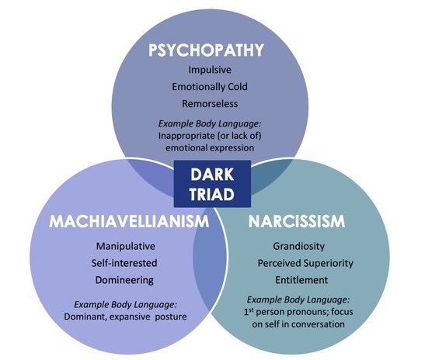
the dark triad
Source: https://en.wikiversity.org/wiki/Motivation_and_emotion/Book/2020/Dark_triad_personality_and_emotion

Slide 93
How did the organization contribute?
They failed to set proper policies.
Examples:
Rules regarding liquor at a company event.
Prohibitions on engaging in a relationship with a subordinate.
Defined working hours.
Job titles and descriptions.
Periodic performance reviews.
Complaint procedures.
Award programs.
Periodic training on issues like discrimination and bias.

Slide 94
the hierarchy
Athena Ainsworth, Equity Partner
Jeff Heaney, Sr Partner and VP HR
Julian Allos, Associate Partner
Rafi Al Jamil, Associate Partner
Vamika Arora, contract paralegal
Heaney was asleep at the switch proclaiming the problems were merely a misunderstanding and some bruised egos.

Slide 95
the hierarchy
Athena Ainsworth, Equity Partner
Jeff Heaney, Sr Partner and VP HR
Julian Allos, Associate Partner
Rafi Al Jamil, Associate Partner
Vamika Arora, contract paralegal
But Heaney was on his way out and perhaps simply didn’t want to fight with two sociopaths.
(Reminder: HR is not your friend.)

Slide 96
what would you do?

Slide 97
what actually happened
After 9 months, Vamika left for a better job.
She decided to avoid formal complaints or legal measures, worried Ainsworth and Allos could harm her career.

